Slide 1
Two-armed Bernoulli bandits in the belief space
Andrea Mazzolini, Como 2019
https://tinyurl.com/y54fvebl

Slide 2
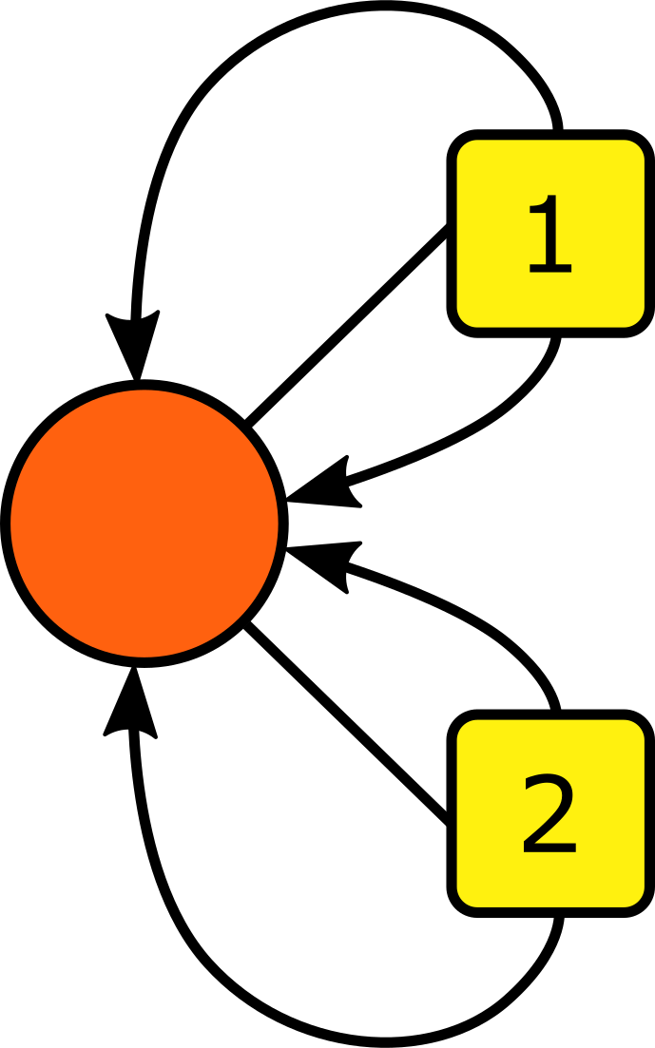
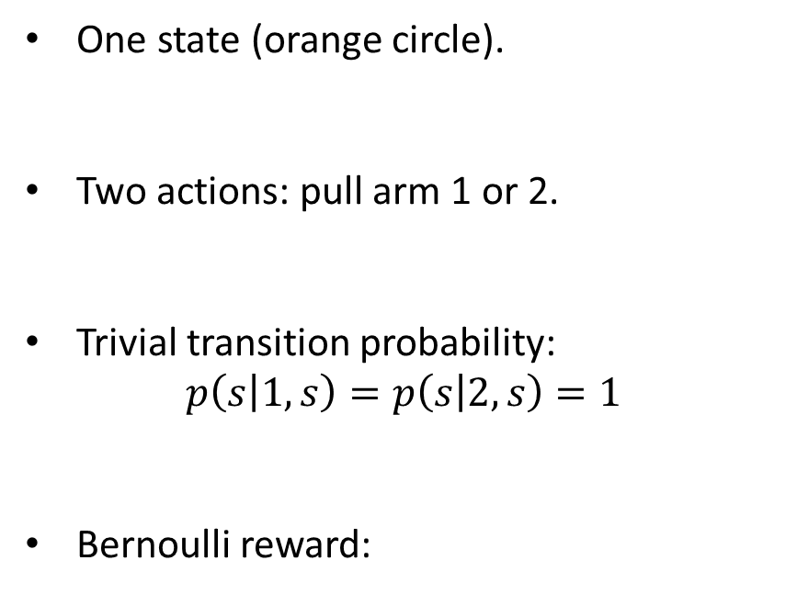
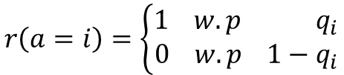
Bandit, hydrogen atom of RL
Prob = 1-q_{1,} reward = 0
One state (orange circle).
Two actions: pull arm 1 or 2.
Trivial transition probability:
$$p\left(s | 1,s\right)=p\left(s | 2,s\right)=1$$
Bernoulli reward:
Prob = q_{1,} reward = 1
Prob = q_{2,} reward = 1
$$r\left(a=i\right)=\left\{\begin{aligned}1 w.p q_{i} \\ 0 w.p 1−q_{i}\end{aligned}\right.$$
Prob = 1-q_{2,} reward = 0

Slide 3
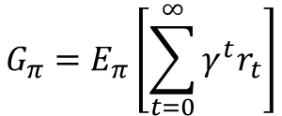
Bandit, hydrogen atom of RL
Prob = 1-q_{1,} reward = 0
Utility function:
$$G_{π}=E_{π}\left[\sum_{t=0}^{∞}{γ^{t}r_{t}}\right]$$
Policy: which action to take
Prob = q_{1,} reward = 1
Reward
Discount factor
Prob = q_{2,} reward = 1
If q₁ and q₂ are known: always exploit the arm with larger q.
Prob = 1-q_{2,} reward = 0

Slide 4
Bandit, hydrogen atom of RL
Prob = 1-q_{1,} reward = 0
Utility function:
$$G_{π}=E_{π}\left[\sum_{t=0}^{∞}{γ^{t}r_{t}}\right]$$
Policy: which action to take
Prob = q_{1,} reward = 1
Reward
Discount factor
Prob = q_{2,} reward = 1
If q₁ and q₂ are unknown???
Exploration -> random choice. Increase the knowledge of q but I loose chances to get the best reward.
Exploitation -> pull the best arm. Without reliable estimates it’s useless.
Prob = 1-q_{2,} reward = 0

Slide 5
Bandit in the belief space
1
Belief on q₂
Belief on q₁
1

Slide 6
Bandit in the belief space
1
q₁ = 1/2
q₁ = 0
Belief on q₂
q₂ = 1
q₂ = 0
Belief on q₁
1

Slide 7
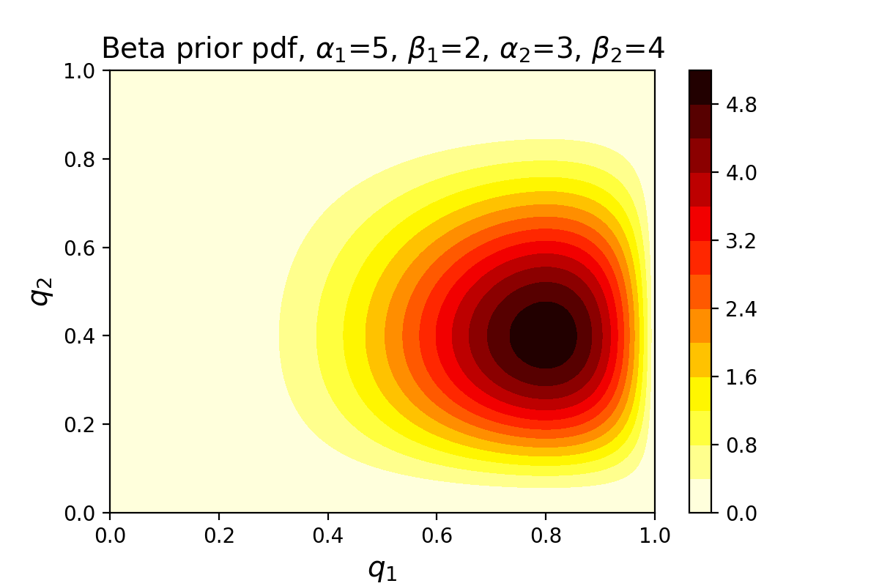
Bandit in the belief space
Assumption: the belief is a Beta distribution and the two beliefs are independent:
$$B\left(q_{1},q_{2}\right)=Beta\left(q_{1}|α_{1},β_{1}\right)Beta({q_{2}|α}_{2}{,b}_{2})$$

Slide 8
Bandit in the belief space
Each time I pull an arm I have a Bernoulli outcome. I can update the belief using Bayes:
$$B_{t+1}\left(q_{1},q_{2}\right)∝l(r_{t}|q_{1},q_{2},a_{t})B_{t}\left(q_{1},q_{2}\right)$$
Beta again!
Beta prior
Bernoulli likelyhood

Slide 9
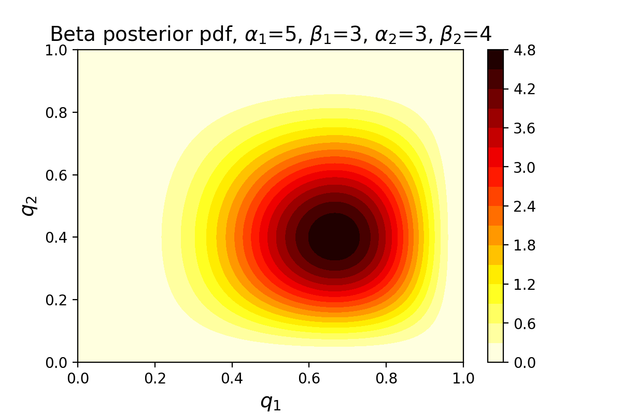
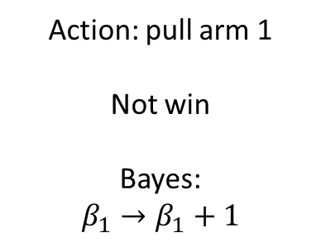
Bandit in the belief space
Each time I pull an arm I have a Bernoulli outcome. I can update the beleif using Bayes:
$$B_{t+1}\left(q_{1},q_{2}\right)∝l(r_{t}|q_{1},q_{2},a_{t})B_{t}\left(q_{1},q_{2}\right)$$
Action: pull arm 1
Not win
Bayes:
$$β_{1}→β_{1}+1$$

Slide 10


Bandit in the belief space
It can be proven that if I start from a flat prior: ${ Beta}_{0}\left(q_{i}|α_{i},β_{i}\right)={Beta}_{0}\left(q_{i}|1,1 \right)=1$
I get the following hyperparameters after t Bayes updates:
$$α_{i}^{(t)}=n_{i}^{(t)}+1$$
$$β_{i}^{(t)}=m_{i}^{(t)}+1$$
Number of wins with arm i
Number of losses with arm i

Slide 11


Bandit in the belief space
It can be proven that if I start from a flat prior: ${ Beta}_{0}\left(q_{i}|α_{i},β_{i}\right)={Beta}_{0}\left(q_{i}|1,1 \right)=1$
I get the following hyperparameters after t Bayes updates:
$$α_{i}^{(t)}=n_{i}^{(t)}+1$$
$$β_{i}^{(t)}=m_{i}^{(t)}+1$$
Number of wins with arm i
Number of losses with arm i
I build a new MDP game in the belief space
The four hyperparamenters
The four counters
Beleif space
Space of the two Betas
$$α_{1},β_{1},α_{2},β_{2}$$
$$n_{1},m_{1},n_{2},m_{2}$$

Slide 12

Belief-space bandit as an MDP
A state is defined by number of wins and losses:
${s=(n}_{1},m_{1},n_{2},m_{2}$)

Slide 13

Belief-space bandit as an MDP
A state is defined by number of wins and losses:
Two actions, the two arms:
${s=(n}_{1},m_{1},n_{2},m_{2}$)
$$a_{t}∈\{1,2\}$$

Slide 14


Belief-space bandit as an MDP
A state is defined by number of wins and losses:
Two actions, the two arms:
${s=(n}_{1},m_{1},n_{2},m_{2}$)
$$a_{t}∈\{1,2\}$$
Transition probabilities are given by estimates of winning or loosing. If I choose action i:
$n_{i}→$ $n_{i}+1$ with prob. $\left\langle q_{i}\right\rangle =\frac{n_{i}+1}{n_{i}+m_{i}+1}$
$m_{i}→$ $m_{i}+1$ with prob. $1−\left\langle q_{i}\right\rangle$

Slide 15
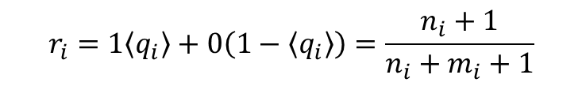
Belief-space bandit as an MDP
A state is defined by number of wins and losses:
Two actions, the two arms:
${s=(n}_{1},m_{1},n_{2},m_{2}$)
$$a_{t}∈\{1,2\}$$
Transition probabilities are given by estimates of winning or loosing. If I choose action i:
The reward is the average win, computed with my estimates:
$n_{i}→$ $n_{i}+1$ with prob. $\left\langle q_{i}\right\rangle =\frac{n_{i}+1}{n_{i}+m_{i}+1}$
$$r_{i}=1\left\langle q_{i}\right\rangle +0\left(1−\left\langle q_{i}\right\rangle \right)=\frac{n_{i}+1}{n_{i}+m_{i}+1}$$
$m_{i}→$ $m_{i}+1$ with prob. $1−\left\langle q_{i}\right\rangle$

Slide 16
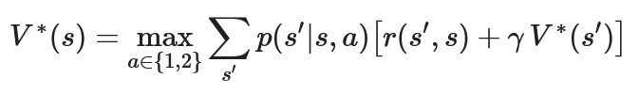

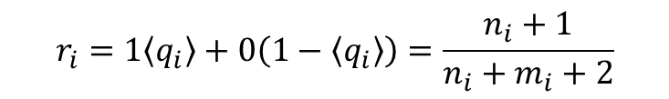
Belief-space bandit as an MDP
A state is defined by number of wins and losses:
Two actions, the two arms:
${s=(n}_{1},m_{1},n_{2},m_{2}$)
$$a_{t}∈\{1,2\}$$
Transition probabilities are given by estimates of winning or loosing. If I choose action i:
The reward is the average win, computed with my estimates:
$n_{i}→$ $n_{i}+1$ with prob. $\left\langle q_{i}\right\rangle =\frac{n_{i}+1}{n_{i}+m_{i}+2}$
$$r_{i}=1\left\langle q_{i}\right\rangle +0\left(1−\left\langle q_{i}\right\rangle \right)=\frac{n_{i}+1}{n_{i}+m_{i}+2}$$
$m_{i}→$ $m_{i}+1$ with prob. $1−\left\langle q_{i}\right\rangle$
I have all the ingredients to write down the Bellman equation, solve it:

Slide 17


Belief-space bandit as an MDP
Two-armed bandit (not knowing the winning probabilities)
$$S=\{s\}$$
Fully observable problem in the belief space.
$$S=ℤ^{4}$$
The solution gives me the best action to take given each possible «state of ignorance», i.e. configuration of wins and losses.

Slide 18
Solving with dynamic programming
Each win/loss counter can take infinite values -> Infinite number of equations!

Slide 19



Solving with dynamic programming
Each win/loss counter can take infinite values -> Infinite number of equations!
The discount factor introduces a time scale: $P\left(t>T\right)=γ^{T}$
Infinite time steps
(1-$γ$) = prob. game stops
$$\max_{π}\left\{E_{π}\left[\sum_{t=0}^{∞}{γ^{t}r_{t}}\right]\right\}$$
Equivalence
$$\max_{π}\left\{E_{π}\left[\sum_{t=0}^{∞}{r_{t}}\right]\right\}$$

Slide 20
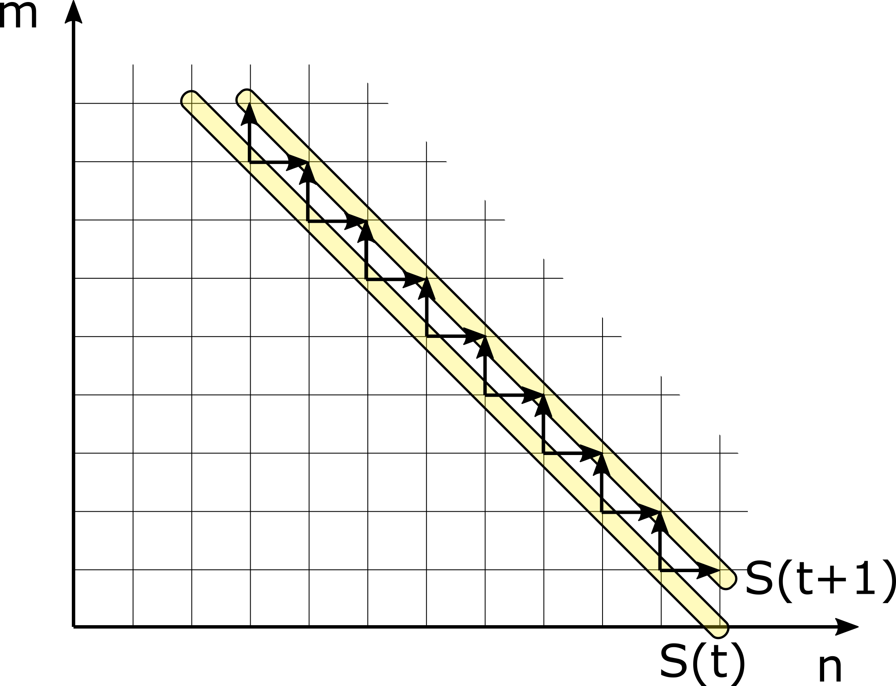
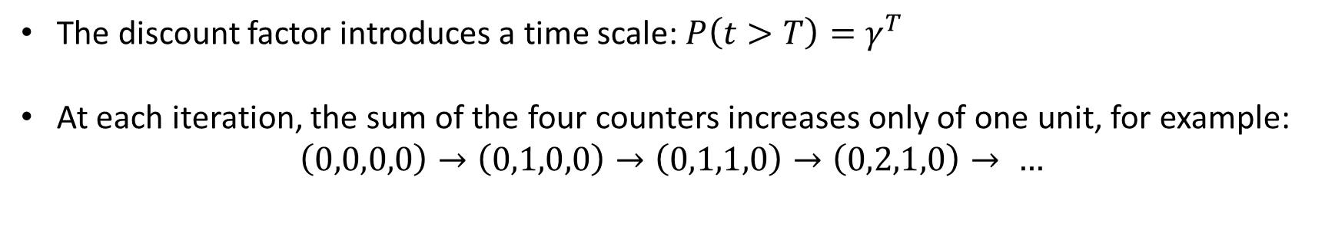

Solving with dynamic programming
Each win/loss counter can take infinite values -> Infinite number of equations!
The discount factor introduces a time scale: $P\left(t>T\right)=γ^{T}$
At each iteration, the sum of the four counters increases only of one unit, for example:
$$\left(0,0,0,0\right)→\left(0,1,0,0\right)→\left(0,1,1,0\right)→\left(0,2,1,0\right)→ …$$
$$S\left(0\right)→S\left(1\right)→S\left(2\right)→…$$

Slide 21
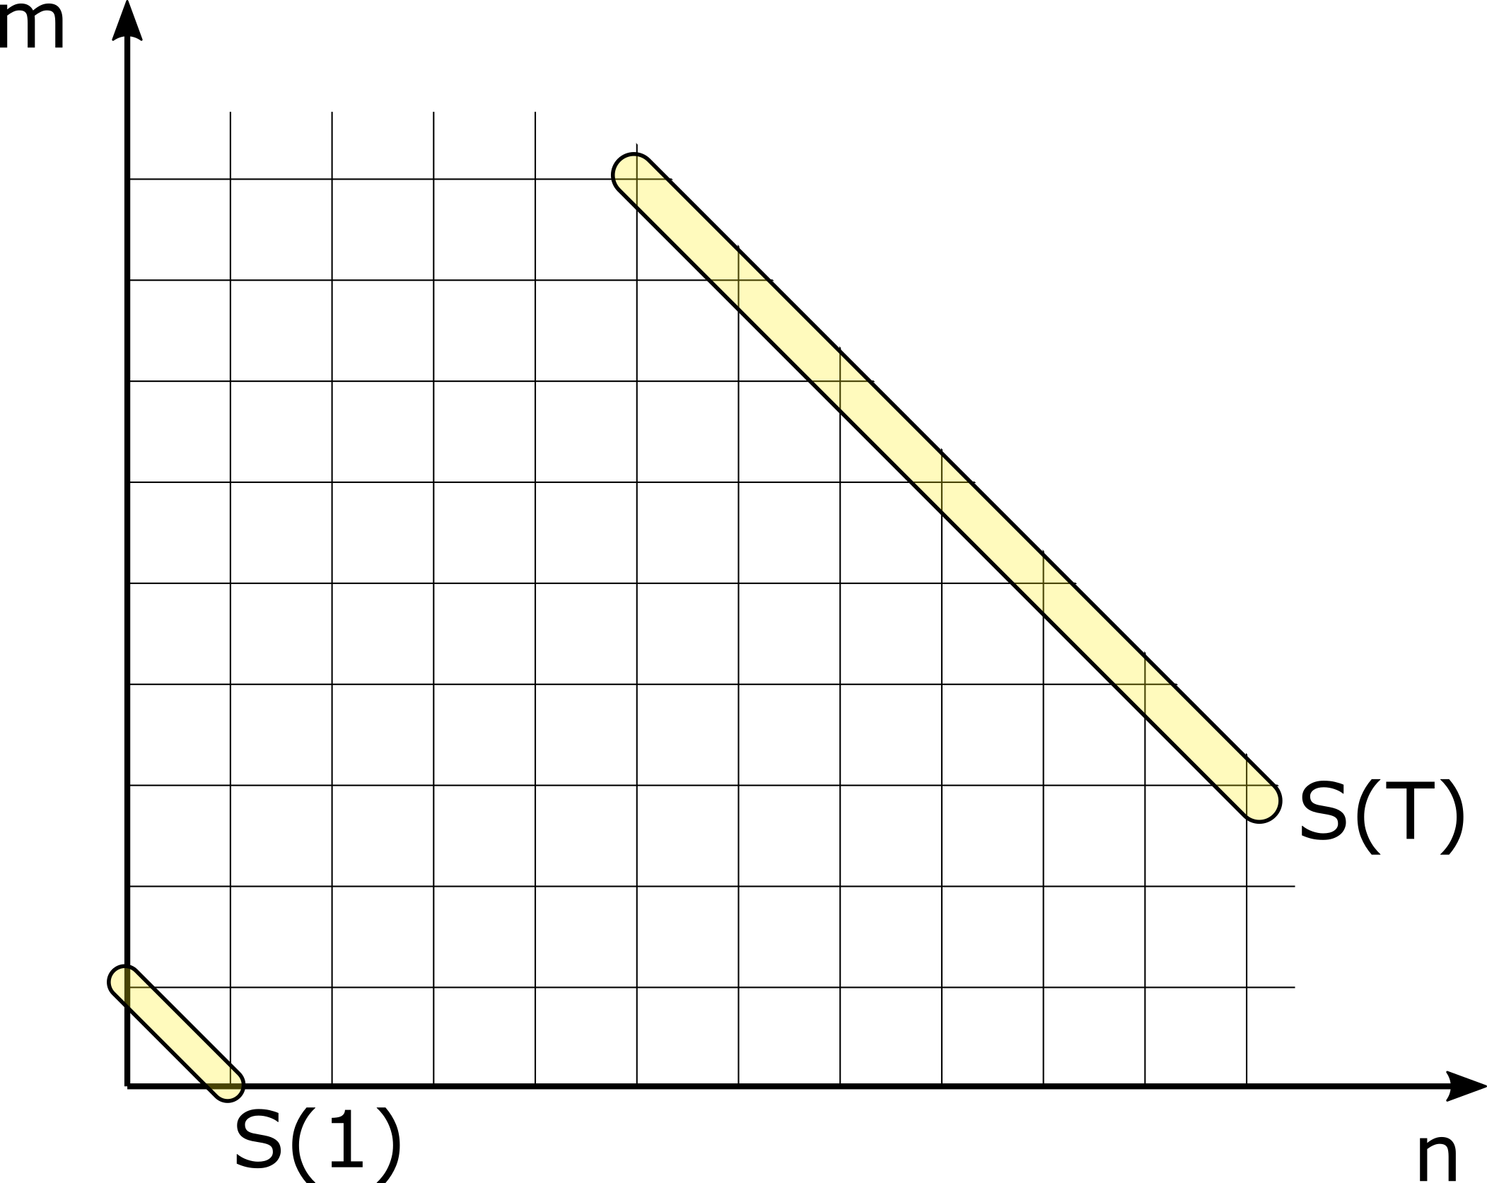



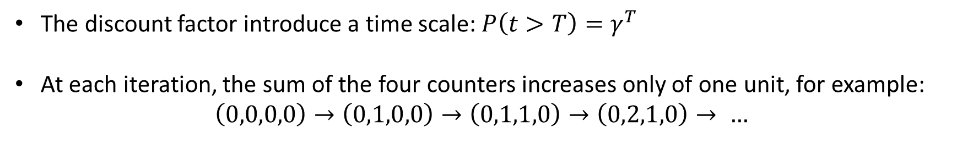
Solving with dynamic programming
Each win/loss counter can take infinite values -> Infinite number of equations!
The discount factor introduce a time scale: $P\left(t>T\right)=γ^{T}$
At each iteration, the sum of the four counters increases only of one unit, for example:
$$\left(0,0,0,0\right)→\left(0,1,0,0\right)→\left(0,1,1,0\right)→\left(0,2,1,0\right)→ …$$
I choose T such that it is very unlikely that the game lasts for more steps:
State space approximation:

Slide 22
Solving with dynamic programming
From a state in S(t) I can jump only in S(t+1)
All the values in S(t) can be computed by knowing the values in S(t+1)

Slide 23
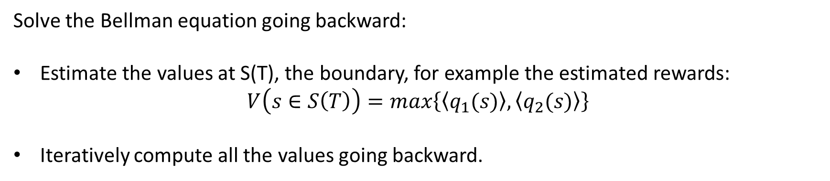
Solving with dynamic programming
Solve the Bellman equation going backward:
Estimate the values at S(T), the boundary, for example the estimated rewards:
$$V\left(s∈S\left(T\right)\right)=max\left\{\left\langle q_{1}(s)\right\rangle ,\left\langle q_{2}(s)\right\rangle \right\}$$
Iteratively compute all the values going backward.

Slide 24
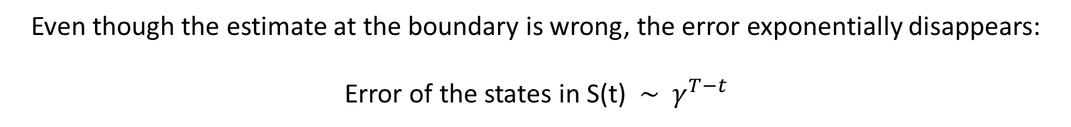
Solving with dynamic programming
Solve the Bellman equation going backward:
Estimate the values at S(T), the boundary, for example the estimated rewards:
$$V\left(s∈S\left(T\right)\right)=max\left\{\left\langle q_{1}(s)\right\rangle ,\left\langle q_{2}(s)\right\rangle \right\}$$
Iteratively compute all the values going backward.
Even though the estimate at the boundary is wrong, the error exponentially disappears:
Error of the states in S(t) $\sim γ^{T−t}$

Slide 25
Solving with dynamic programming
$$V\left(s∈S\left(t\right)\right)=\max_{a}E\left[r+γV\left(sεS(t+1\right)\right]=\max_{a}\left\{E\left[r\right]+E\left[γV\left(sεS(t+1\right)\right]\right\}=$$
$$=something + γ∙a function of V\left(sεS(t+1\right))$$
$$=something + γ∙something + … + γ^{T−t}a function of V\left(sεS(T\right))$$
Even though the estimate at the boundary is wrong, the error exponentially disappears:
Error of the states in S(t) $\sim γ^{T−t}$

